Slide 1
ICS632 Final Project
--- GMT Optimization
Hualiang Li

Slide 2
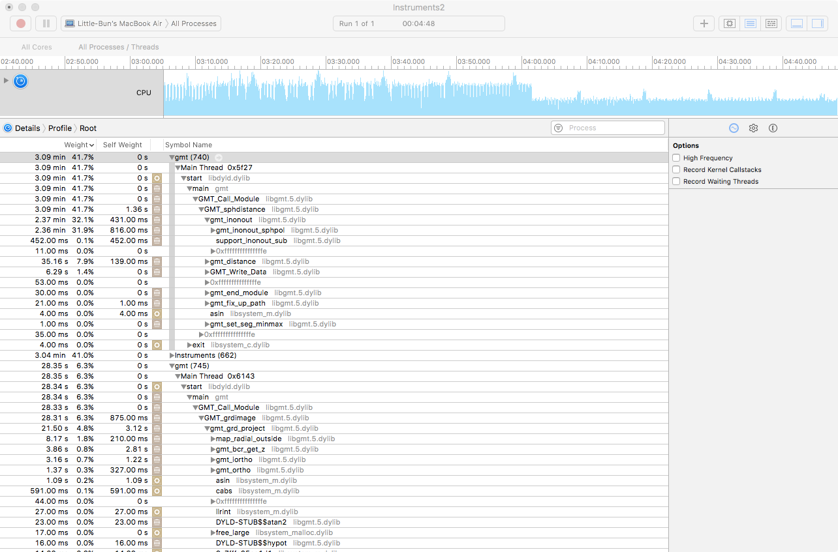
What I have done?
1. Use gprof/Mac instrument find critical part (Ahmdal’s Law)

Slide 3
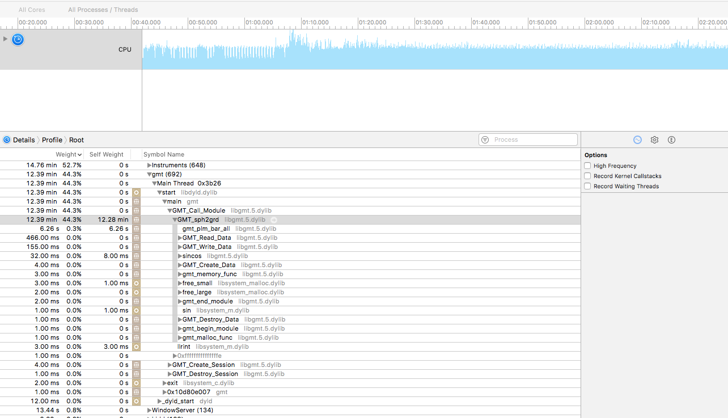
What I have done?

Slide 4
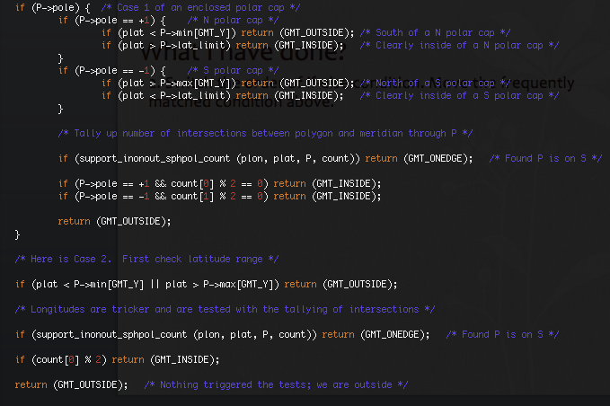
What I have done?
2. Switch the order of if-else condition. Move the frequently matched condition above.

Slide 5
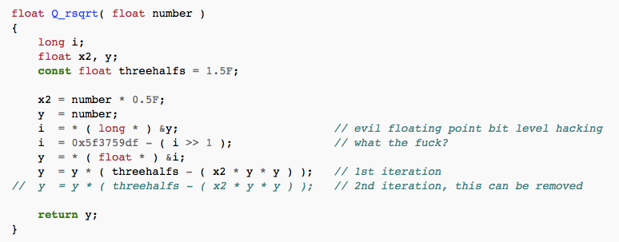
What I have done?
3. Inline function / Macro
4. Implement sqrt function used by “sphdistance”
From Wikipedia

Slide 6
What I have done?
5. OPENMP Parallelize
sphdistance
Spharm

Slide 7
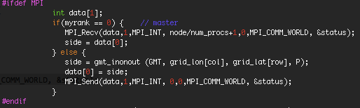
What I have done?
MPI (In progress)
Idea: each non-master process compute some parts of the grid, and send it to master.
Issue: the output is not correct, probably race condition.

Slide 8
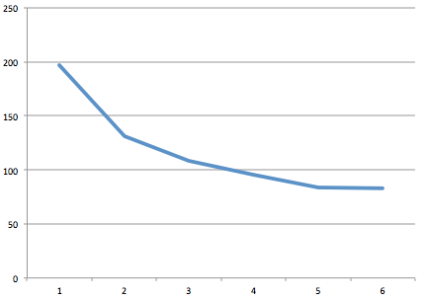
Result
Switch the order of if-else condition. (1.2 seconds less on 10 trials run)
Inline / MACRO (0.2 seconds more …)
Fast inverse sqrt (1 second less )
OPENMP (speedup of 2.5 with 5 cores for sphdistance, speedup of 15 with 20 cores for spharm)

Slide 9
